Slide 1
TDD and BDD
Notes:
20170313
Copyright © 2017 nTier Training, LLC. All rights reserved.
0-<number>
TDD and BDD

Slide 2
Course Agenda
Section 1 Agile Testing Principles
Section 2 JUnit Overview
Section 3 Test Driven Development (TDD)
Section 4 Creating Testable Code
Section 5 Behavior-Driven Development
20170313
Copyright © 2017 nTier Training, LLC. All rights reserved.
0-<number>
Notes:
20170313
Copyright © 2017 nTier Training, LLC. All rights reserved.
0-<number>
TDD and BDD

Slide 3
The Agile Potential
The Chaos Report – More bad news
When a bridge falls down, it is investigated and a report is written on the cause of the failure. This is not so in the computer industry where failures are covered up, ignored and/or rationalized. As a result, we keep making the same mistakes over and over again
The Standish Group CHAOS Report (see below)
  All numbers are percentages
Type | 1995 | 2000 | 2004 | 2006 | 2008 | 2010 | 2012
Succeeded | 16 | 28 | 29 | 35 | 32 | 31 | 39
Failed | 31 | 23 | 18 | 19 | 24 | 21 | 18
Challenged | 53 | 49 | 53 | 46 | 44 | 42 | 43
20170313
Copyright © 2017 nTier Training, LLC. All rights reserved.
0-<number>
Notes:
20170313
Copyright © 2017 nTier Training, LLC. All rights reserved.
0-<number>
TDD and BDD

Slide 4
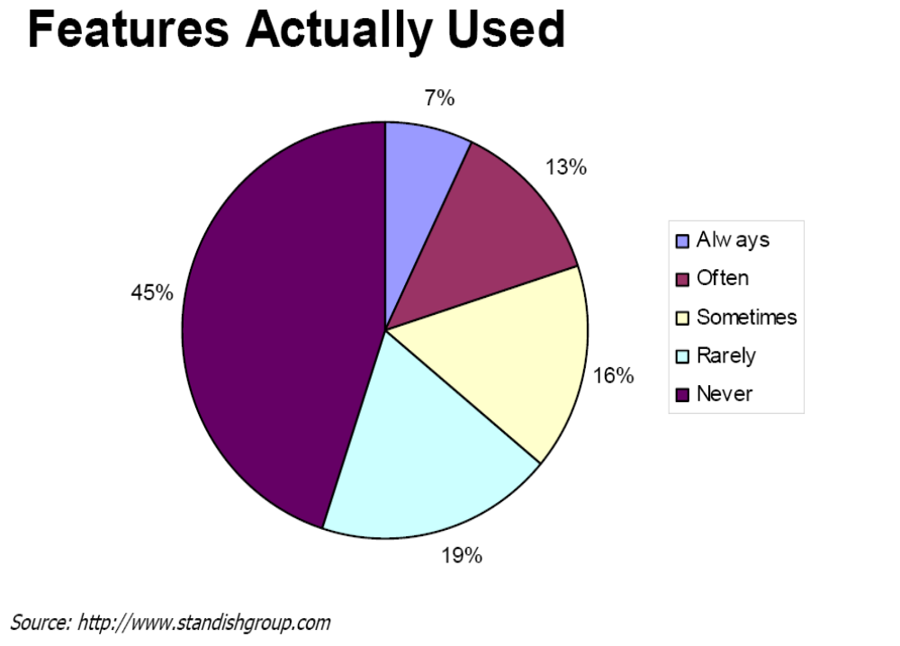
Does the Business Know What is Needed?
The Standish Group survey found that approximately 45% of features in systems are never used
  What are impacts to Total Cost of Ownership (TCO)?
  How can business partners know what is valuable to customers?
Focus of business needs to be on ROI at the feature level
  Application of 80/20 rule
20170313
Copyright © 2017 nTier Training, LLC. All rights reserved.
0-<number>
Notes:
Why do projects fail?
http://www.youtube.com/watch?v=52yjQEEdnso
20170313
Copyright © 2017 nTier Training, LLC. All rights reserved.
0-<number>
TDD and BDD

Slide 5
Microsoft Survey
http://research.microsoft.com/en-us/groups/ese/nagappan_tdd.pdf
Better Design. TDD is considered as much of (and in some cases, more of) a design process than a test process
Efficiency. The fine granularity of the test-then-code cycle gives continuous feedback to the developer. With TDD, faults and/or defects are identified very early and quickly as new code is added to the system
Test Assets. The automated unit test cases written with TDD are valuable assets to the project. Subsequently, when the code is enhanced, modified or updated, running the automated unit tests may be used for the identification of newly introduced defects
Reducing Defect Injection
20170313
Copyright © 2017 nTier Training, LLC. All rights reserved.
0-<number>
Notes:
20170313
Copyright © 2017 nTier Training, LLC. All rights reserved.
0-<number>
TDD and BDD

Slide 6
Results of Microsoft Survey
All our experiences and lessons learned point to the fact that TDD seems to be applicable in various domains and can significantly reduce the defect density of developed software without significant productivity reduction of the development team
  Start TDD from the beginning of projects
  For a team new to TDD, introduce automated build test integration towards the second third of the development phase—not too early but not too late
  Convince the development team to add new tests every time a problem is found
  Get the test team involved and knowledgeable about the TDD approach
  Hold a thorough review of an initial unit test plan, setting an ambitious goal of having the highest possible (agreed upon) code coverage targets
  Constantly running the unit test cases in a daily automatic build
20170313
Copyright © 2017 nTier Training, LLC. All rights reserved.
0-<number>
Notes:
Copyright © 2017 nTier Training, LLC. All rights reserved.
0-<number>
20170313
TDD and BDD

Slide 7
I Do Not Have Time for Unit Tests!
Check out this study by Peter Hallam from the Visual Studio team at Microsoft:
  http://blogs.msdn.com/b/peterhal/archive/2006/01/04/509302.aspx
According to Hallam, developers actually spend their days like this (while not reading Code Rant of course :):
  Writing new code 5%
  Modifying existing code 25%
  Understanding Code 70%
If there was a technique that allowed you to cut the amount of time spent modifying and understanding code in half by doubling the amount of time spent writing new code, you could deliver a new feature in just 60% of the time - almost doubling your productivity!
20170313
Copyright © 2017 nTier Training, LLC. All rights reserved.
0-<number>
Notes:
http://mikehadlow.blogspot.com/2011/06/i-dont-have-time-for-unit-tests.html
http://www.dalkescientific.com/writings/diary/archive/2012/12/13/version_control_and_user_testing.html
20170313
Copyright © 2017 nTier Training, LLC. All rights reserved.
0-<number>
TDD and BDD

Slide 8
Cont.
TDD is that technique
  Allows for safe modifications
    If you break something when you modify some code, the unit tests fail
  Shortens the iteration cycle between writing/running code
    No more need to step through your application to the part where your new code gets exercised
  Mistakes in your code are shallow and obvious
    No more need to step through code in the debugger, wondering which part of your application is broken
  Code is self-documenting
    The unit tests explicitly show how the author expected the code to be used
  Code is decoupled
    You can’t do TDD without decoupling. This alone makes the code easier to understand as a unit and much safer to modify
20170313
Copyright © 2017 nTier Training, LLC. All rights reserved.
0-<number>
Notes:
Note that I’m just talking about feature-delivery productivity here. I haven’t mentioned the huge gains in stability and the drop in bug-counts
Now, I don’t deny that TDD is a fundamentally different way of working that takes time to learn. Undoubtedly productivity may drop while a developer is getting up to speed, but (in my experience) the argument that a developer doing TDD is slower than a developer who doesn’t do it is simply not true
20170313
Copyright © 2017 nTier Training, LLC. All rights reserved.
0-<number>
TDD and BDD

Slide 9
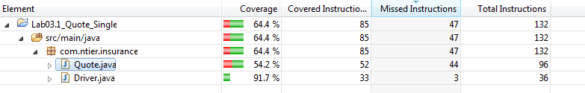
Plugin For Code Coverage
EclEmma code coverage – MarketPlace type eclemma
EclEmma is a free Java code coverage tool for Eclipse, available under the Eclipse Public License. It brings code coverage analysis directly into the Eclipse workbench:
  Fast develop/test cycle: Launches from within the workbench like Junit. Test runs can directly be analyzed for code coverage
  Rich coverage analysis: Coverage results are immediately summarized and highlighted in the Java source code editors
  Non-invasive: EclEmma does not require modifying your projects or performing any other setup
20170313
Copyright © 2017 nTier Training, LLC. All rights reserved.
0-<number>
Notes:
Copyright © 2017 nTier Training, LLC. All rights reserved.
0-<number>
20170313
TDD and BDD

Slide 10
End of Section
This page is intentionally devoid of any useful content
20170313
Copyright © 2017 nTier Training, LLC. All rights reserved.
0-<number>

